Slide 1
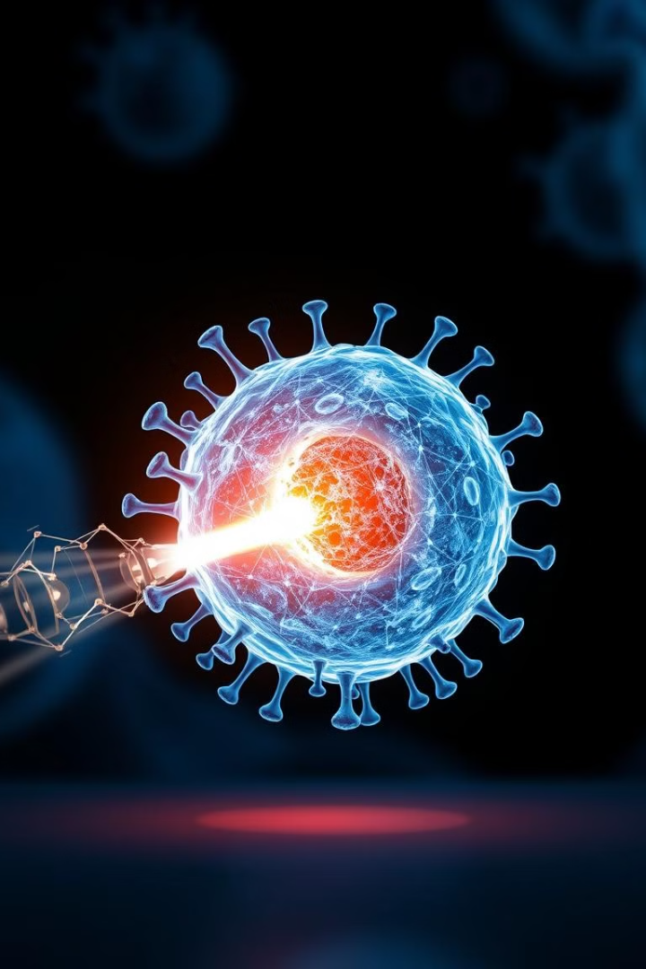
Single-Wall Carbon Nanotube Nanobomb Agents for Killing Breast Cancer Cells
Presented by:
Gul Fatima
Areeba Asim
Rizwa Fatima
Wasif Ali Khan

Slide 2
Table of content
Introduction
Nanobiotechnology in cancer diagnostics
Quantum dots for cancer diagnostics
Viral capsids for drug delivery
Magnetic particles for cancer therapy
Nanoshells and SWCNTs for cancer therapy
SWCNTs nanobombs for cancer therapy
SWCNTs synthesis method
Nanobomb activation and cell death
Advantages of nanobomb
Results of SWCNTs
Future approaches

Slide 3
Introduction:
Despite advances in cancer biology, clinical progress has been limited by the lack of highly selective therapeutic agents.
Furthermore, it is most striking to recognise that only 1 to 10 parts per 100,000 of intravenously injected monoclonal antibodies reach their targets in vivo.
Nanotechnology offers a promising solution, with nanoparticles, nanowires, and SWCNTs, therapeutic technologies that can potentially reach their targets with maximum selectivity and minimum collateral damage.

Slide 4
Nanobiotechnology in Cancer Diagnostics
Today, cancer-related nanotechnology research is progressing on two main fronts:
1-Laboratory-based diagnostics
2-In vivo diagnostics and therapeutics
Nanowire Grids
Nano-Cantilevers
Silicon nanowires coated with antibodies detect tumor markers with high sensitivity.
Nano-cantilevers coated with DNA or protein-binding molecules detect single molecules.
Designed in the laboratory use sophisticated lithographic techniques to fabricate the grids.
It can detect a single molecule of DNA or protein due to the change in the surface stresses that bend the nano-cantilever, which is detected using optical techniques

Slide 5
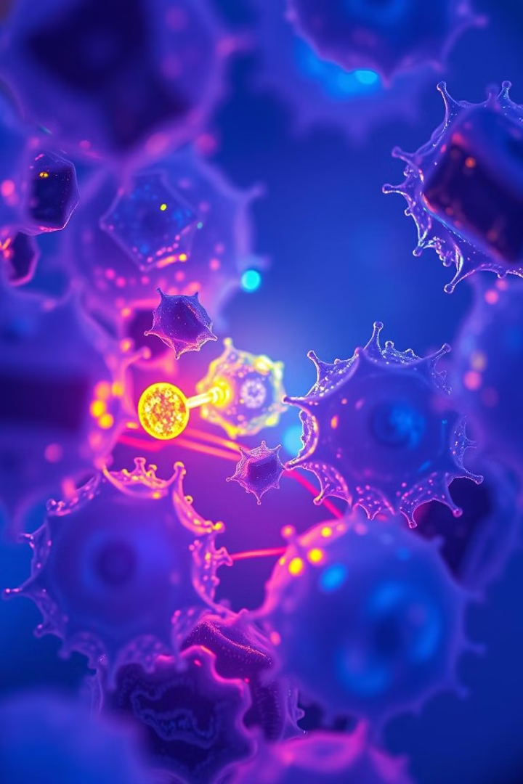
Quantum Dots for Cancer Detection
1
Quantum dots of cadmium selenide
2
Optical Properties
The use of semiconductor nanocrystals or quantum dots of cadmium selenide as a tool for laboratory diagnostics of cancer
Quantum dots change their optical properties based on size.
3
Multiplexing Potential
4
Beacon Technology
Quantum dots can detect multiple substances simultaneously.
Quantum dots linked to antibodies act as beacons, lighting up upon binding.

Slide 6
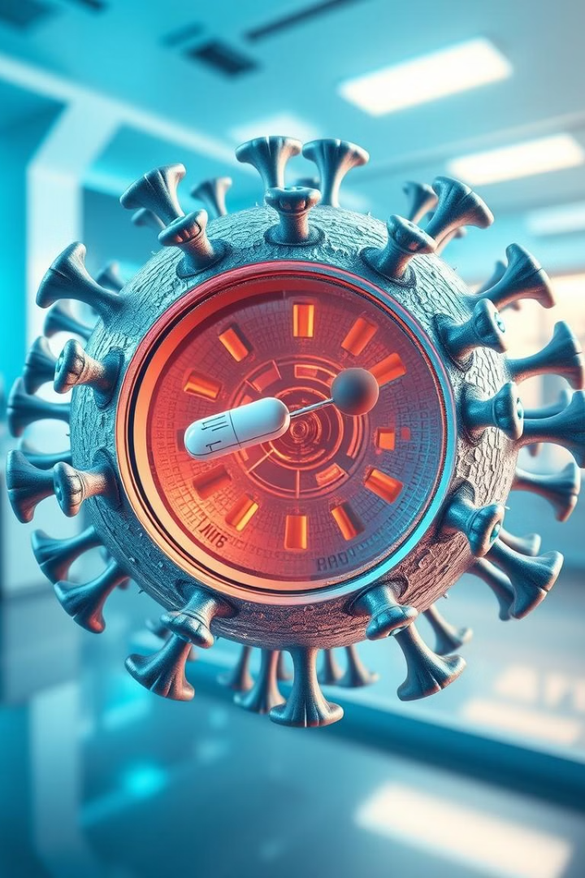


Virus Capsids for Drug Delivery
Homing Molecules
Drug Delivery Vehicles
Researchers have used empty RNA virus capsids as potential contrast agents for magnetic resonance imaging (MRI) by attaching homing molecules such as monoclonal antibodies or cancer cell–specific receptor antagonists, and reporter molecules.
Therapeutic agents loaded inside the capsid can also serve as drug-delivery vehicles.
That therapeutic agents work as efficient drug towards cancer cells.

Slide 7
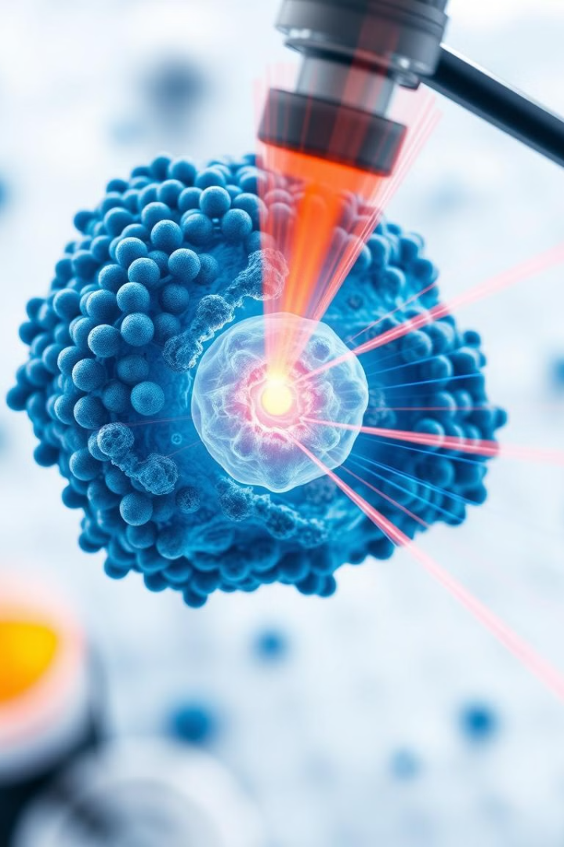
Magnetic Nanoparticles for Cancer Therapy
1
Targeted Delivery
Silica-coated lipid micelles containing LH-RH deliver iron oxide nanoparticles to cancer cells.
2
Magnetic Heating
Oscillating magnetic fields heat the nanoparticles, killing cancer cells.

Slide 8



Nanoshells and SWCNTs for Cancer Therapy
1
2
3
Infrared Radiation
Temperature
Cell Killing
Nanoshell, and more recently SWCNT, technology to kill cancer cells by using infrared radiation and imaging has proved to be a successful approach for cancer cell killing in vivo
Lasers with very high power were used to heat the nanoshell and SWCNT to 55–70°C.
The level of temperature increase in SWCNT to create nanobombs that explode at low laser intensities.
By exploding SWCNT that are co-localized with cancer cells, one can selectively destroy the SWCNT as well as the cancer cells. This approach may be the only way of using SWCNT for therapeutics without causing any toxicity problems

Slide 9




SWCNT Nanobombs for Cancer Therapy
1
Thermal Energy Confinement
2
Vaporization of Liquids
3
Pressure Build-up
4
Explosion
Nanobombs are created due to the thermal-energy confinement in SWCNT bundles and subsequent vaporization of liquids between SWCNT in bundles creating pressures that cause the eventual explosion. This phenomenon works in a host of different liquids such as alcohol, deionized (DI) water, and phosphate-buffered saline solutions
Notes:
Nanobombs are created due to the thermal-energy confinement in SWCNT bundles and subsequent vaporization of liquids between SWCNT in bundles creating pressures that cause the eventual explosion. This phenomenon works in a host of different liquids such as alcohol, deionized (DI) water, and phosphate-buffered saline solutions

Slide 10
SWCNT SYNTHESIS METHOD
SWCNT Growth
3. SWCNT Sheet Fabrication
Single-wall carbon nanotubes (SWCNT) are first grown in-house using methane-based thermochemical vapor deposition technique at 900°C and atmospheric pressures using iron and nickel as catalyst metals. The growth is set in the reaction rate–limited regime with high temperatures facilitating high kinetic energy of the gas molecules and with low supply of carbon, allowing the formation of SWCNT
Dispersion and Filtration
SWCNT were dispersed in deionized water and a sheet was created by vacuum filtration. The SWCNT sheets were made by vacuum filtration of 20 mL of a 0.6-mg/mL SWCNT suspension through a poly(tetrafluoroethylene) filter (Millipore LS, 47 mm in diameter, 5-µm pores).
Washing and Drying
The SWCNT sheet was washed with 200 mL of deionized water and then 100 mL of methanol to remove residual NaOH and surfactant.
2. Purification
The grown SWCNTs are purified by first heating in dry air at 400°C to remove the soot and an acid reflux (3 M HCl for 10 h) to remove the catalyst particles
The sheets were allowed to dry under continued vacuum purge for 1 h before being peeled from the filter

Slide 11
4. Cell Culture and Treatment
5. SWCNT Dispersion and Delivery
BT474 Breast Cancer Cells
SWCNT Dispersion
Two 1-mm wells, 1 mm apart, were created on the SWCNT sheet as sites to deposit 1.0 µL aliquots of approx 1 × 105 BT474 breast cancer cells freshly resuspended in PBS after release from culture dishes. Clusters of BT474 cells on the bottoms of the wells were stained with Trypan blue dye to investigate membrane permeability and cell damage before and after light exposure
0.1 µg of SWCNT were dispersed in PBS solution and agitated for 24 h until all the SWCNT were dispersed. The SWCNT in PBS do not precipitate even after 24 h and are quite stable.
Targeted Delivery
The dispersed SWCNT suspension is then directly adsorbed onto the center of a larger cluster of BT474 cells that has been treated with Trypan blue dye and light. This targeted delivery allows for localized cell killing.
Light Exposure
One well is exposed to 800 nm laser light at 200 mW/cm2 for 60 seconds. This targeted light exposure is intended to activate the SWCNT nanobombs, inducing cell damage.

Slide 12




Nanobomb Activation and Cell Death
1
Light Absorption
2
Heat Generation
3
Cell Membrane Damage
4
Cell Death
The SWCNT nanobombs, upon light exposure, absorb energy and generate heat. This heat induces localized damage to the cell membrane, leading to cell death. This process demonstrates the potential of SWCNT nanobombs for targeted cancer therapy.

Slide 13
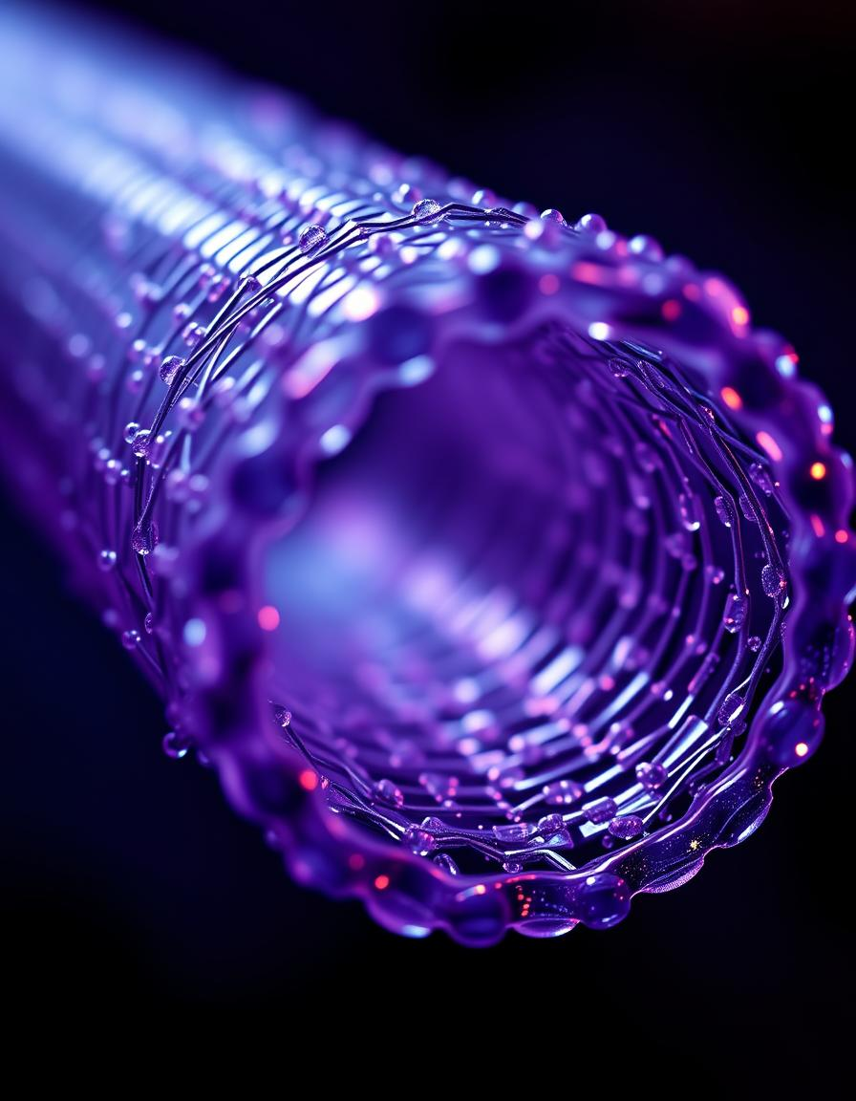
Advantages of SWCNT Nanobombs
High Specificity
Enhanced Efficacy
SWCNT nanobombs can be targeted to specific cancer cells, minimizing damage to healthy tissues.
The localized heat generation by SWCNT nanobombs effectively kills cancer cells with minimal side effects.
Biocompatibility
Potential for Toxicity Reduction
SWCNTs exhibit good biocompatibility, making them suitable for therapeutic applications.
SWCNT are completely destroyed, reducing toxicity concerns

Slide 14
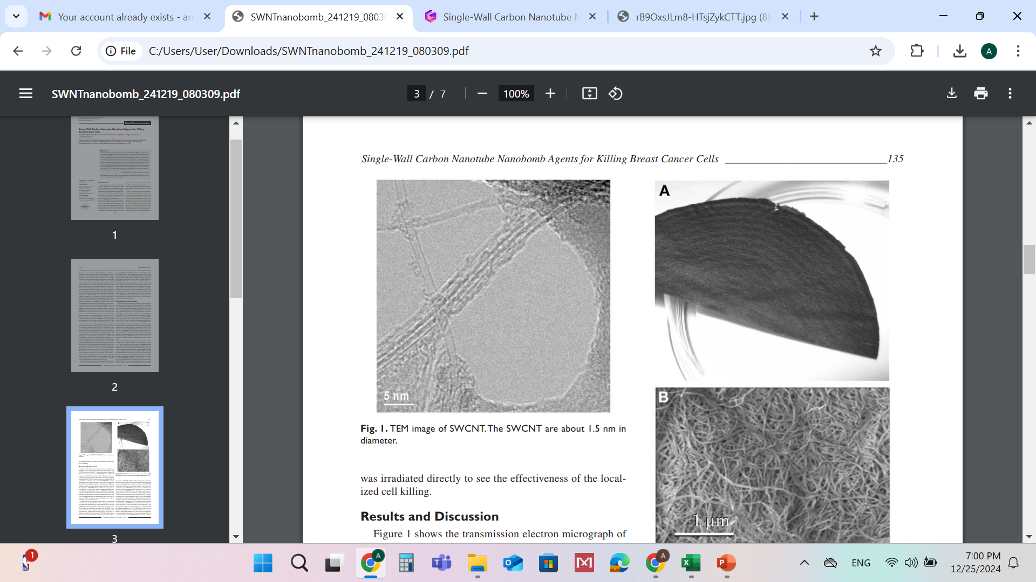
Results of SWCNT Nanobombs
Figure A shows the macroscopic sheet of SWCNT that was fabricated using vacuum filtration technique.
Figure B shows the scanning electron micrograph of the sheet consisting of highly entangled SWCNT
Shows the transmission electron micrograph of SWCNT grown using the procedure described above. The SWCNT grown are about 1.5–4 nm in diameter.

Slide 15
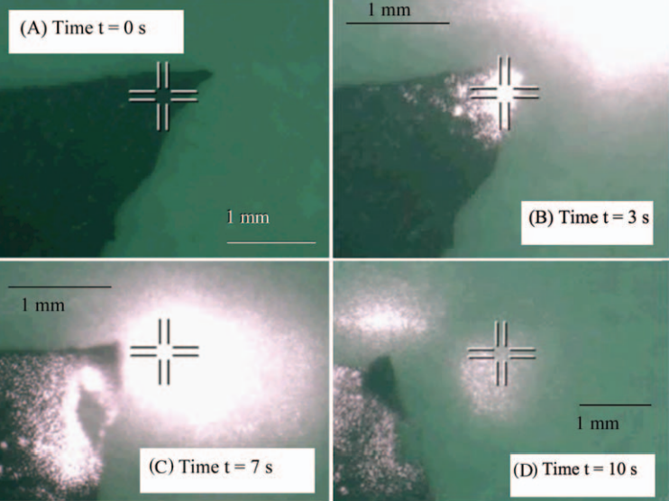
We created sheets to make arrays of immobilized cells that were treated with SWCNT to clearly demonstrate the explosion effect. We found the SWCNT sheets that were highly entangled in DI water and in PBS can explode on exposure to near infrared light
Figures A–D show the explosions of SWCNT sheets in DI water on exposure to 200 mW/cm2 of laser light. These dramatic explosions are caused by the optothermal transitions in SWCNT, which heat to more than 100°C the water molecules that are present in the nanopores between bundles, creating explosions

Slide 16
Explosions in air
Explosions in air of loosely packed SWCNT have been observed previously. However, such explosions were ascribed to the thermal energy confinement in loosely packed SWCNT and the burning due to adsorption of oxygen causing ignition.
It was noted that when SWCNT were compacted, the thermal energy was dissipated rapidly to the surroundings, which made the explosions occur only at high laser energy.
We have found that SWCNT could explode even in the compacted form as sheets and bundles at laser intensities of 50–200 mW/cm2. We postulate that this phenomenon arises both from high heat confinement inside the tubes, and from high heat confinement between the SWCNT when the SWCNT are compacted together.
The high optical absorbance in SWCNTs originates between the first and second van Hove singularities in SWCNT (18,19).
Heat is also generated in SWCNT due to the electron–phonon coupling causing molecular vibrations

Slide 17
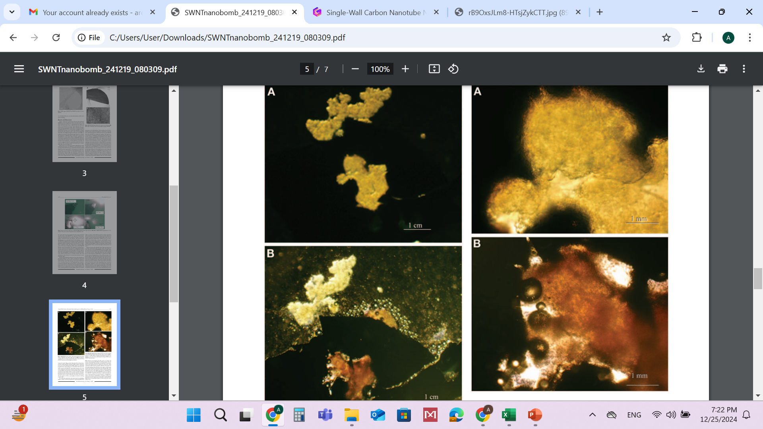
Figure A BT474 breast cancer cells placed inside two etched holes on SWCNT sheet before light exposure
Figure B after exposure to 200 mW/cm2 of light intensity. The cells in the well of the SWCNT sheet that received light were ablated.

Slide 18
Figure A High magnification image of BT474 cell cluster treated with SWCNT and Trypan blue dye before light exposure.
Figure B on exposure to 200 mW/cm2 of light intensity. Note that there are bubbles on the cell cluster indicating the boiling of PBS due to SWCNT heat emission.

Slide 19
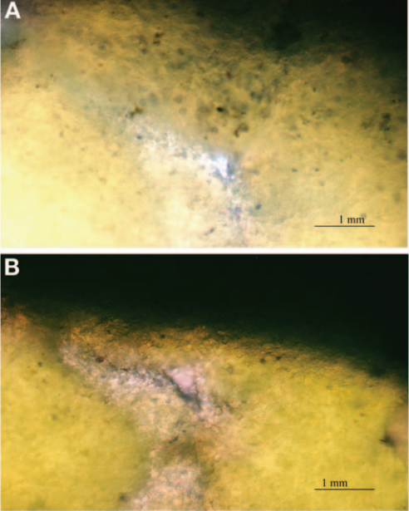
Figure A BT474 cells that were treated with SWCNT in PBS suspension before light exposure;
Figure B after light exposure to 50 mW/cm2. Note that the center part that turned blue is the site that was exposed to light,while the surrounding cells appear normal. This illustrates the precision of cancer cell killing in the central region by this approach.

Slide 20
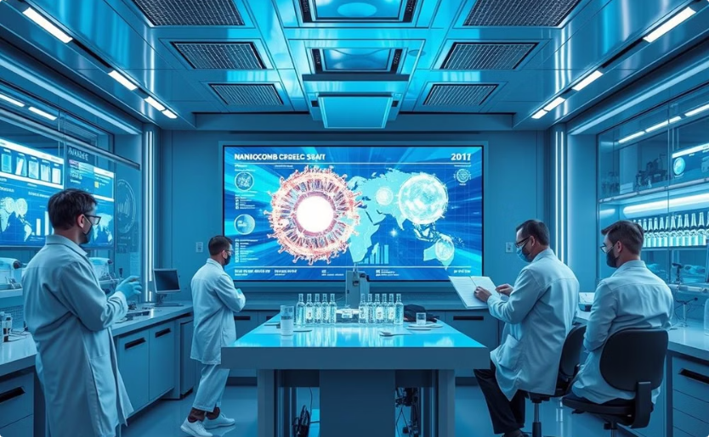
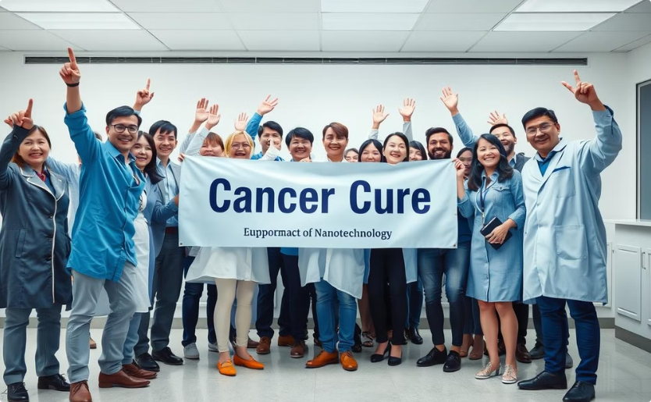
Conclusion: A Promising Future
Nanobombs
Future Research
The research presented in this presentation demonstrates the potential of SWCNT nanobombs as a novel and effective approach to killing cancer cells. The technology offers several advantages over traditional therapies, including high selectivity, minimal collateral damage, and the ability to overcome toxicity concerns.
Further research is needed to fully understand the mechanism of SWCNT nanobomb activation and to optimize their use for clinical applications. However, the initial results are promising and suggest that SWCNT nanobombs could revolutionize cancer treatment in the future.

Slide 21
THANK YOU

